Slide 1
FS2021-XYZ IBM Cloud Pak for Integration Deployment, Practical Field Experience & Lessons Learned Top 5 Inhibitors Impacting Sales Progression & Deployment — Thomas (Tom) Campbell WW Technical Sales Leader, Integration
#cpfield-cp4integration
Used in this Channel to discuss CP4i Inhibitors during this session

Slide 2
Legal Disclaimer
© IBM Corporation 2021. All Rights Reserved.
The information contained in this publication is provided for informational purposes only. While efforts were made to verify the completeness and accuracy of the information contained in this publication, it is provided AS IS without warranty of any kind, express or implied. In addition, this information is based on IBM’s current product plans and strategy, which are subject to change by IBM without notice. IBM shall not be responsible for any damages arising out of the use of, or otherwise related to, this publication or any other materials. Nothing contained in this publication is intended to, nor shall have the effect of, creating any warranties or representations from IBM or its suppliers or licensors, or altering the terms and conditions of the applicable license agreement governing the use of IBM software.
References in this presentation to IBM products, programs, or services do not imply that they will be available in all countries in which IBM operates. Product release dates and/or capabilities referenced in this presentation may change at any time at IBM’s sole discretion based on market opportunities or other factors, and are not intended to be a commitment to future product or feature availability in any way. Nothing contained in these materials is intended to, nor shall have the effect of, stating or implying that any activities undertaken by you will result in any specific sales, revenue growth or other results.
Performance is based on measurements and projections using standard IBM benchmarks in a controlled environment. The actual throughput or performance that any user will experience will vary depending upon many factors, including considerations such as the amount of multiprogramming in the user's job stream, the I/O configuration, the storage configuration, and the workload processed. Therefore, no assurance can be given that an individual user will achieve results similar to those stated here.
All customer examples described are presented as illustrations of how those customers have used IBM products and the results they may have achieved. Actual environmental costs and performance characteristics may vary by customer.

Slide 3
Agenda
Session Objectives and Format
Rules of the Road & Guardrails
Meet the Panel Subject Mater Experts
Top 5 Inhibitors Discussions
Call to Action

Slide 4
Session Objectives & Format
Session Objectives & Format:
The purpose of this session is to review and discuss (virtually) leading technical inhibitors impacting CP4I sales progression & adoption. We will also discuss available remediation assets and options.
Feedback has been collected from WW Geo Leaders. Panel Subject Matter Experts have assessed and prioritized a list of ‘5 Top’ inhibitors.
For each inhibitor, SMEs will discuss the context for the inhibitor and discuss best practices, field experience and existing assets that can be used to mitigate these issues.
Rules of the Road & Guradrails:
For each identified inhibitor, we will allocate 8 minutes for SMEs to discuss including mitigation and mediation.
We will use the published C&CS Feedback Loop for Cloud Pak process as guidance.
We encourage attendee post comments and question through the #cpfield-cp4integration Slack channel.
Panel SMEs will monitor the Slack channel for Q&A to address questions.
We will continue to use this Slack channel post FastStart to continue our dialog and to feed the feedback loop process.

Slide 5



Identification Phase: Is an inhibitor a Defect or is there a need for a Product Enhancement?
Technical Field: Use Slack channel per Cloud Pak where help needed to answer questions and/or determine if sales inhibitor is a defect or requires a product enhancement.
#cpfield-cp4data #cpfield-cp4integration #cpfield-cp4applications #cpfield-cp4automation #cpfield-cp4mcm #cpfield-cp4security
Geo tech sales ambassadors: monitor Slack to assist with responses.
OM and Development: monitor Slack for hot inhibitors to help with determination.
Field Inhibitor
Identified
Defect
OR
Enhancement
IBM Support
Processes
Enhancement Request
Referral

Slide 6


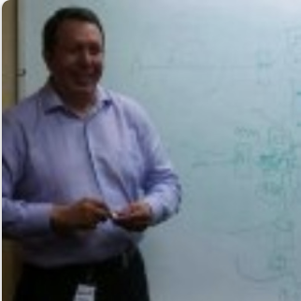
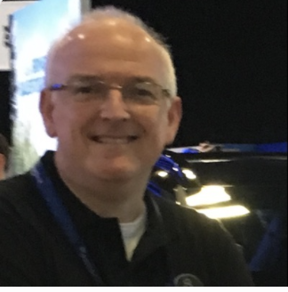



Meet the Panel Subject Matter Experts
Prasad Imandi
SWAT, IBM Integration
Andy Humphreys
Program Director, OM CP4I
Joel Gomez
WW Synergy, CP4I Technical Sales
Andy Garrett
Technical OM, CP4I
Dan Temkin
Americas Technical Sales Leader, Integration
Carmen Raileanu
EMEA Technical Sales Leader, Integration
Thomas (Tom) Campbell
WW Technical Sales Leader, Integration

Slide 7
Top 5 Inhibitors…

Slide 8
Inhibitor # 1
Cloud Pak for Integration Resource Requirements
Use cases define requirements
OpenShift considerations
CP4I calculator tool

Slide 9
Inhibitor #2
Deployment Architecture
From sizing to deployment
Cloud Pak deployment
What about high availability

Slide 10
Inhibitor #3
Storage for Cloud Pak for Integration
Underlying Problem & Root Causes?
Storage Recommendations & Guidance
Storage Architecture & Capacity Planning
Storage requirements for different components in the Cloud Pak

Slide 11
Inhibitor #4
Cloud Pak for Integration Licenses
Trade up – value in Cloud Pak and OpenShift
OpenShift entitlements
License service and reporting

Slide 12
Inhibitor #5
Container and RedHat OpenShift Skills
VMs vs Containers
Kubernetes / OpenShift
Guidance on skills for customers

Slide 13
Call to Action
Let’s keep momentum generated from this session going and let’s keep the conversation active in the #cpfield-cp4integration Slack Channel.
Proactively leverage the tools, assets and resources we have discussed today to remove any technical blockers to your Client engagements. Don’t wait for the Client to raise these objections.
Going forward, leverage the ‘C&CS Feedback Loop for Cloud Pak’ process to report additional inhibitors, product quality issues and feedback on supporting technical assets.
Please take the time to provide your feedback regarding our overall Cloud Pak 2.0 strategy as well as our Cloud Pak for Integration roadmap direction (positive and negative feedback please).
Key Slack Channels
#icp4i-tech – Information, Q&A
#ns-id-tech-sales - Information, Q&
#ww-integration-tech-sales - Information, Q&
#cpfield-cp4integration – Inhibitors only
#fs-techsales-integration – FastStart only
#fs21-emea-ts-integration-appliccaton – FastStart only

Slide 14
Useful Assets, Links & Back-Up

Slide 15
Inhibitor # 1
Cloud Pak for Integration Resource Requirements
Use cases define requirements
What core capability/capabilities are required?
Discuss High Availability Requirements
Which capabilities can / should be shared?
What specific functionality is needed per capability?
i.e., APIC Test & Monitor or Designer Map Assist
Understand the extra resources needed

Slide 16
Inhibitor # 1
Cloud Pak for Integration Resource Requirements
Use cases define requirements
What extra components are needed
i.e., Asset Repository or Operations Dashboard (base or unrestricted)
Agile Integration – Granular Deployment
App Connect
How many instances?
How many are Toolkit-based vs. Designer-based
How many need Tracing?

Slide 17
Inhibitor # 1
Cloud Pak for Integration Resource Requirements
Integration Server Pod
Integration Server Pod
Integration Server Pod
Integration Runtime
Think about instances
Integration Server Pod
Integration Runtime
Integration Server Pod
Message Flow(s)
Integration Runtime
Message Flow(s)
Integration Runtime
Message Flow(s)
Integration Server Pod
Integration Runtime
Message Flow(s)
Message Flow(s)
Integration Runtime
Message Flow(s)
Integration Server Pod
Toolkit based flows
Integration Runtime
CPU Limit
Sidecars
Message Flow(s)
Chargeable Component
Tracing Agent
Sidecar
Tracing Collector
Sidecar

Slide 18
Inhibitor # 1
Cloud Pak for Integration Resource Requirements
Think about instances & capabilities
Designer based flows
Integration Server Pod
Integration Server Pod
Integration Server Pod
Integration Runtime
Integration Runtime
Integration Runtime
Message Flow(s)
Message Flow(s)
Message Flow(s)
Toolkit based flows
Designer Flows
Sidecar
Designer Connectors
Sidecar
Designer Flows
Sidecar
Designer Connectors
Sidecar
CPU Limit
Sidecars
Tracing Agent
Sidecar
Tracing Collector
Sidecar
Chargeable Component

Slide 19
Inhibitor # 1
Cloud Pak for Integration Resource Requirements
Integration Server Pod
Think about instances & capabilities
Integration Runtime
Designer Flow Engine
and Connectors
Sidecar
Integration Server Pod
Message Flow(s)
Integration Runtime
Designer based API flows
Message Flow(s)
Integration Server Pod
Toolkit based flows
Integration Runtime
Designer Flow Engine
and Connectors
Sidecar
CPU Limit
Sidecars
Message Flow(s)
Tracing Agent
Sidecar
Tracing Collector
Sidecar
Chargeable Component

Slide 20
Inhibitor # 1
Cloud Pak for Integration Resource Requirements
Designer based Event flows
Think about instances & capabilities
Integration Server Pod
Integration Server Pod
Integration Server Pod
Integration Runtime
Integration Runtime
Designer Flow Engine
and Connectors
Sidecar
Designer Flow Engine
and Connectors
Sidecar
Message Flow(s)
Integration Runtime
Message Flow(s)
Message Flow(s)
Event Connectors
Sidecar
Event Connectors
Sidecar
Event Proxy
Sidecar
Event Proxy
Sidecar
Toolkit based flows
CPU Limit
Sidecars
Tracing Agent
Sidecar
Tracing Collector
Sidecar
Chargeable Component

Slide 21
Inhibitor # 1
Cloud Pak for Integration Resource Requirements
Think about instances
MQ Pod
Integration Server Pod
Queue Manager
Integration Runtime
Message Flow(s)
API Gateway Pod
Tracing Agent
Sidecar
Tracing Collector
Sidecar
Toolkit based flows
DataPower Gateway
CPU Limit
Sidecars
Tracing Agent
Sidecar
Tracing Collector
Sidecar
Chargeable Component

Slide 22
Inhibitor # 1
Cloud Pak for Integration Resource Requirements
OpenShift Considerations
Self-Managed?
Master Nodes
Storage Requirements
Node Capacity
Overcommit
allocatable
(available for pods)
kube-reserved
system-reserved
eviction-threshold

Slide 23
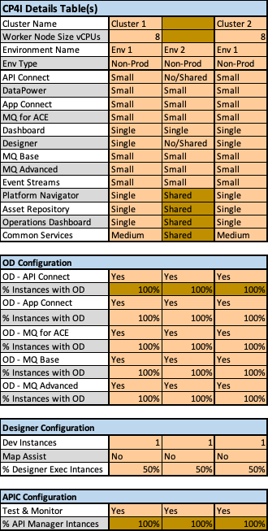
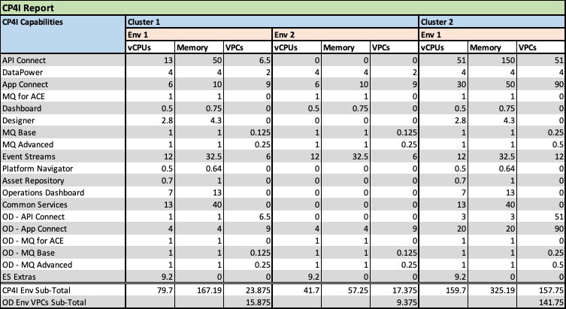
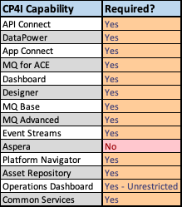
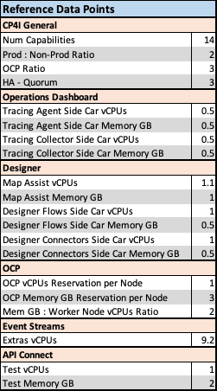
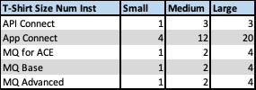
Inhibitor # 1
Cloud Pak for Integration Resource Requirements
CP4I Calculator available in Seismic:
https://bit.ly/3rfS1A4

Slide 24
Inhibitor #2
Deployment Architecture
From Sizing to Deployment
An example
Capabilities | Non-Prod Total | Licenses
ACE | 4 cores | 6
APIC | 16 cores | 8
MQ | 4 cores | 1
Event Streams | 16.2 cores | 9
Platform Navigator | 0.25 cores | -
Cores and Licenses Needed | 48.2 cores | 24 VPCs
Node | Services | CPU | RAM
Master (3) | OCP Master | 8 (3) | 16
Worker 1 | Common Services | 8 | 32
Worker 3 | Integration workload | 16 | 32
Worker 4 | Integration workload | 16 | 32
Worker 5 | Integration workload | 16 | 32
 |  | 80 cores
Integration Playbook/ February 2021/ © 2021 IBM Corporation

Slide 25
Inhibitor #2
Deployment Architecture
Install Infra architecture (vSphere, bare metal, Cloud)
OpenShift install (Installer provisioned, User provisioned, Air gapped, Online)
High availability - OpenShift and Integration workload
Cloud Pak for Integration 2020.4.1 301 Level Deck
https://ibm.box.com/s/bfhrxr1lsxdpphibsf4odhj6i4caa80p

Slide 26
Inhibitor #3
Storage for Cloud Pak for Integration
Remediation Options
References
Seismic – SS4CP Page
https://ibm.biz/BdfHni
Seismic - CP4I 301 Client Deck
https://ibm.biz/BdfHnj
Seismic – Architecting RHOCS
https://ibm.biz/BdfHnZ
RedHat - RHOCS Sizing Tool
https://ibm.biz/BdfHn2
Your Learning 3 Party Series
https://ec.yourlearning.ibm.com/w3/event/10160355
Part 1 mp4
https://ibm.ent.box.com/s/82a3kckhq2gqbq4ynoidaj5zjo0cprgr
Part 1 ppt
https://ibm.ent.box.com/s/pgn24fti0qy7uug000f7mupe3r6zhj2y
Underlying Problem
Ephemeral vs Persistent Storage
Infra Tier & Application Tier Data Requirements
Root Causes
Oversite
Additional Cost
Sales Team Dynamics
Increased Complexity
Introducing…
IBM Storage Suite Suite for Cloud Paks
Storage Suite for Cloud Pak - SS4CP
Storage Recommendations & Guidance
Engage your IBM Storage Team
Secure the Data Foundation
Top Down – Know the workload
Bottom Up – Know the infrastructure
WIN the Data Control Plane architecture battle…
Watch out for Competitive FUD.
‘…IBM is mandating a container architecture…’
Multi-Mode Storage (File, Block, Object)
Multi-compute architecture (x86, Power, Z)
Container Ready / Container Native
CSI Standards
Validated by IBM and RedHat
Tightly coupled release cycle

Slide 27






Storage Suite Starter for Cloud Paks
Cloud Pak for Applications
Cloud Pak for
Data
Cloud Pak for Integration
Cloud Pak for Automation
Cloud Pak for Multicloud Management
Cloud Pak for Security
Cloud Paks for Integration: Dec 11, 2020
Other Cloud Paks: TBD
IBM Storage Suite for IBM Cloud Paks
IBM Spectrum Scale
IBM Spectrum Discover
IBM Spectrum Virtualize
IBM Cloud
Object Storage
Software-defined storage for Cloud Pak for Data and Cloud Pak for Integration deployments
What’s included?
Included free-of-charge software-defined storage for Cloud Pak for Data and Cloud Pak for Integration deployments
Up to 12TB of Red Hat OpenShift Container Storage
Up to 12TB of IBM Spectrum Scale, IBM Spectrum Virtualize for Public Cloud, and/or IBM Spectrum Discover
Note that IBM Cloud Object Storage and Red Hat Ceph Storage are NOT included
Fully supported by IBM in production environments (Level 1 and Level 2)
Time limit 36-months
Seed IBM Storage and Red Hat OpenShift Container Storage into Cloud Pak deployments
Position Storage Suite for Cloud Paks in Cloud Pak sales opportunities as the preferred and validated storage option
Strengthen IBM’s positioning as a one-stop-shop, offering end-to-end solution from Cloud Paks to Storage
Notes:
We are very excited to introduce Storage Suite Starter for Cloud Paks. The first Cloud Paks to include this entitlement will be Cloud Pak for Integration and IBM Cloud Pak for Data.
One of the key benefits for IBM to introduce Storage Suite Starter for Cloud Paks to our Cloud Pak clients is to seed and showcase IBM Storage offerings into these client environments. IBM offers great software defined storage solutions for containerized workloads, it is a great opportunity for our customers to capitalize these solutions.
Storage Suite Starter for Cloud Paks will be part of the Cloud Pak catalog as the preferred and validated storage option for IBM Cloud Paks, instilling confidence with Cloud Pak clients. As well as positioning IBM as the one-stop-shop for an end-to-end solution.
Note to sellers:
IBM Cloud Object Storage and Red Hat Ceph are not included, despite both offerings being part of the standard Storage Suite for Cloud Paks
The time limit for this entitlement is 36-months
CP4I and CP4D will be the first Cloud Paks to include Storage Suite Starter for Cloud Paks, with ETA in the next 6-8 weeks (Dec 2020 and Jan 2021). The rest of the Cloud Paks will follow.

Slide 28
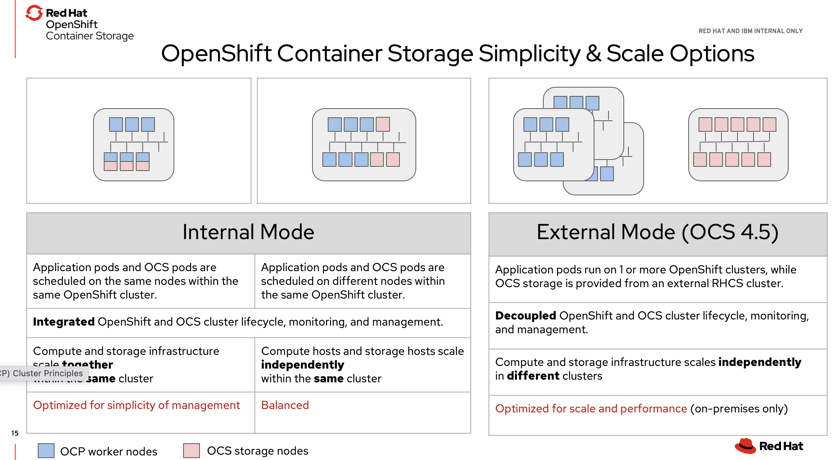
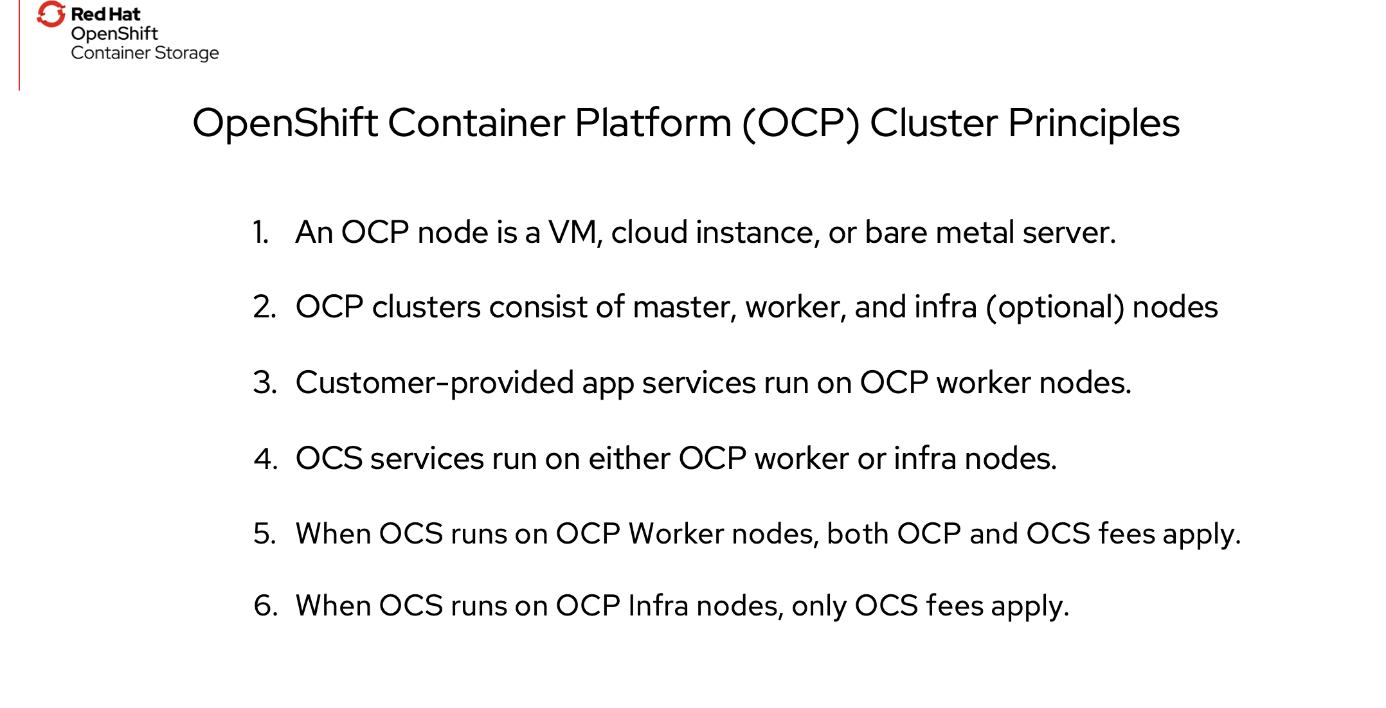
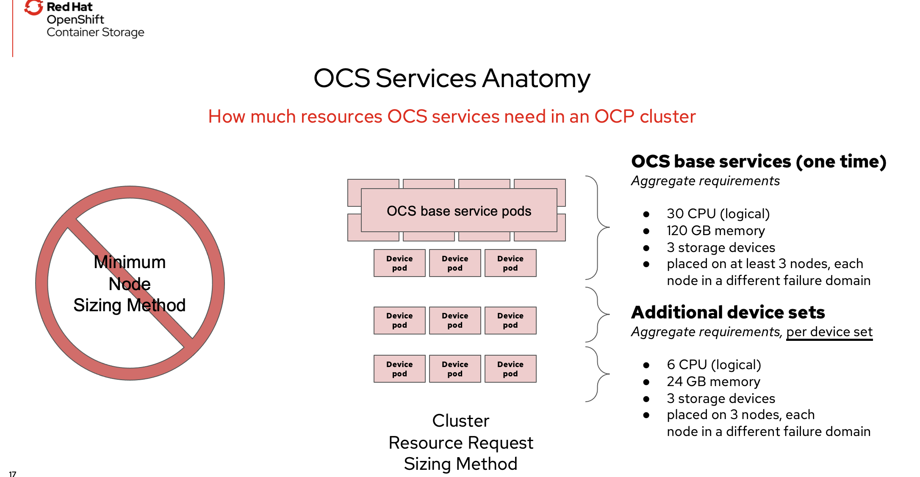
Inhibitor #3
Storage for Cloud Pak for Integration
Remediation Options

Slide 29
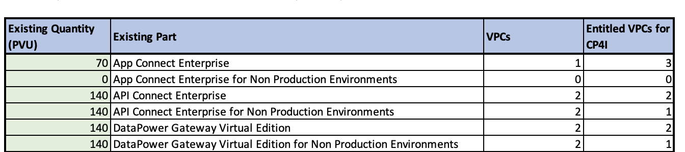
Inhibitor #4
Cloud Pak for Integration Licenses
Trade up – value in Cloud Pak and OpenShift
Value Statements: Know Your Customer! What value resonates with your audience:
Flexibility in Licensing e.g.: Non-Prod, Capability Access/Rebalancing…
Cloud Pak Only Features e.g.: Certified Containers, Tracing, Asset Repo, Pre-Integrated Monitoring/Logging…
Cost Savings e.g.: 70 PVU to 1 VPC (benefits 100, 120+ PVU Cores), Non-Prod….
Rapid Calculator: https://ibm.seismic.com/Link/Content/DCDs39x_ERFkCHhtCOh4JfgQ
Validate what will be deployed as CP4I vs. Licensed as CP4I
Create a topology proposal & evaluate and review for needing additional capacity, OCP entitlement, storage, etc.

Slide 30
Inhibitor #4
Cloud Pak for Integration Licenses
OpenShift entitlements - https://www.ibm.com/support/knowledgecenter/SSGT7J_20.4/planning/licensing.html
Capability | Production - VPC to License | Non-Production – VPC to License | OpenShift Entitlement
App Connect Enterprise | 1:3 | 2:3 | 3:1 for all Licensed VPC to which the customer is entitled https://www.ibm.com/support/knowledgecenter/SSGT7J_20.4/planning/licensing.html
API Connect | 1:1 | 2:1
DataPower | 1:1 | 2:1
MQ Advance | 2:1 | 4:1
MQ Advanced HA Replica | 10:1 | 20:1
MQ Base | 4:1 | 8:1
MQ Base HA Replica | 20:1 | 40:1
Event Streams | 1:1 | 2:1
Aspera HSTS 1 Gbps | 1:4 | 1:2
Add-On Operation Dashboard Unrestricted | 1:1 with the VPCs of the bundled program(s) [not always total CP4I entitlement)
Confluent Add-On | N/A – Different Part | N/A – Different Part | None

Slide 31
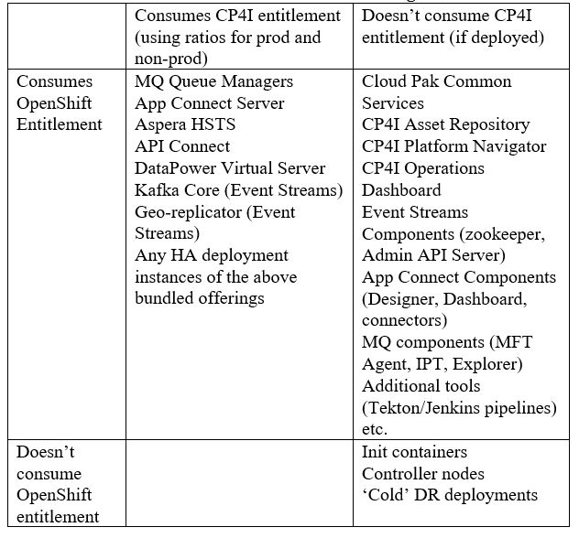
Inhibitor #4
Cloud Pak for Integration Licenses
What consumes IBM Cloud Pak for Integration license entitlements according to the ratio? https://www.ibm.com/support/knowledgecenter/SSGT7J_20.4/planning/licensing.html
IBM's container Licensing approach is defined and described in detail at https://www.ibm.com/software/passportadvantage/containerlicenses.html
Software Policies
https://www-03.ibm.com/software/sla/sladb.nsf/sla/software_policies/

Slide 32
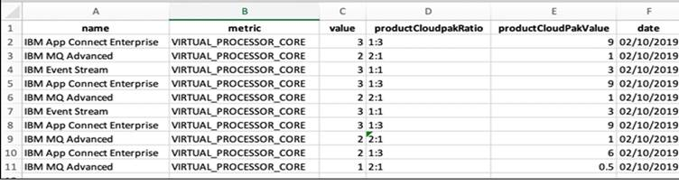
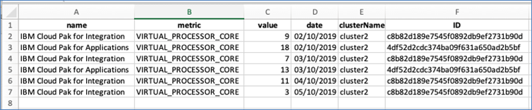
Inhibitor #4
Cloud Pak for Integration Licenses
License service and reporting
High Water Mark for tracking
5 Minute Windowing
Based on Limit not Request

Slide 33
Inhibitor #5
Container and RedHat OpenShift Skills
Remediation Options
Know your targeted workload and targeted runtime technology (VMs or Containers)
Know your targeted infrastructure. On-prem vs public cloud. RHOCP target, Storage tier,
Know how to access IBM resources
Recognize your individual skills and skill gaps, prioritize your learning and identify learning resources
Assess your client’s skills and skill gaps. Be prepared to fill these gaps w/ IBM resources. Be prepared to offer learning resources to you clients.
IBM / RedHat Resources
RedHat Partner Connect
https://partnercenter.redhat.com/Dashboard_page
RedHat OPEN Training System
https://training-lms.redhat.com/lmt/clmsbrowsev2.prMain?in_sessionid=35A110981A1451AA
Public Resources
Udemy training
https://ibm-learning.udemy.com/
O’Reilly
https://learning.oreilly.com/home/

Slide 34
Top 5 Inhibitors…
Cloud Pak for Integration Resource Requirements – Joel
Deployment Architecture Best Practices - Prasad
Storage for Cloud Pak for Integration – Tom
Cloud Pak for Integration Licensing - Dan
Container and RedHat OpenShift skills - Tom

Slide 35
Thank you
Thomas Campbell
WW Technical Sales Leader, Integration
—
campbeth@us.ibm.com

